Slide 1
ABI Commission on Consumer Bankruptcy
DFW Chapter 13 Seminar
October 23, 2017
“To Infinity and Beyond”

Slide 2
Presented by:
Michael T. Bates
JPMorgan Chase & Co.
Vice President – Assistant General Counsel:
Alane Becket
Becket & Lee LLP
Alice Whitten
Wells Fargo Law Department: Vice President - Senior Counsel

Slide 4
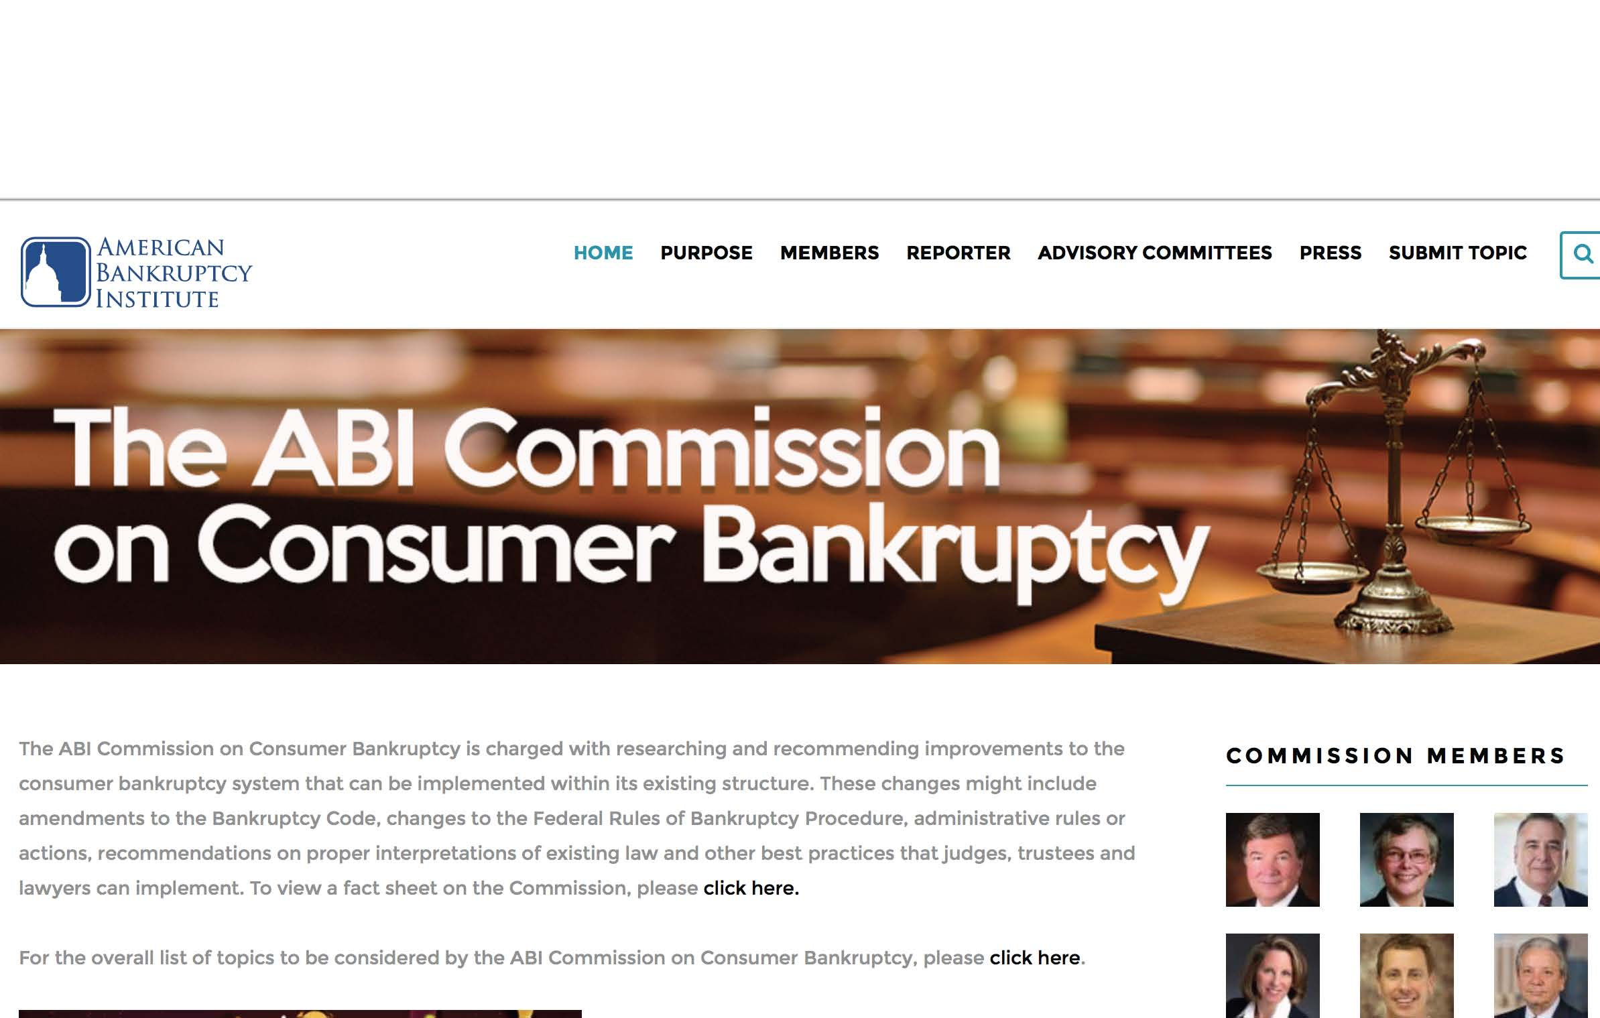

Slide 5
Purpose:
The ABI Commission on Consumer Bankruptcy is charged with researching and recommending improvements to the consumer bankruptcy system that can be implemented within its existing structure. These changes might include amendments to the Bankruptcy Code, changes to the Federal Rules of Bankruptcy Procedure, administrative rules or actions, recommendations on proper interpretations of existing law and other best practices that judges, trustees and lawyers can implement.

Slide 6
ABI Commission on Consumer Bankruptcy
Fact Sheet
Created in December 2016.
17-member panel to examine the consumer bankruptcy system and issue a report with recommended improvements that can be implemented within the existing structure.
An open, information-gathering process that will allow interested parties across the consumer bankruptcy spectrum to provide input.

Slide 7
ABI Commission on Consumer Bankruptcy
Fact Sheet
Co-chaired by retired Bankruptcy Judges William Houston Brown and Elizabeth Perris.
Commission Reporter is Robert Lawless, the Max L. Rowe Professor of Law and co- director of the Program on Law, Behavior & Social Science at the University of Illinois College of Law.

Slide 8
ABI Commission on Consumer Bankruptcy
Fact Sheet
The Commission is supported by three committees:
Case Administration and the Estate
Committee on Chapter 7
Committee on Chapter 13
5 Commissioners and 10 Committee Members per Committee.
Committee recommendations that are approved by a two-thirds majority of the Commission will become part of the Commission's final report.

Slide 9
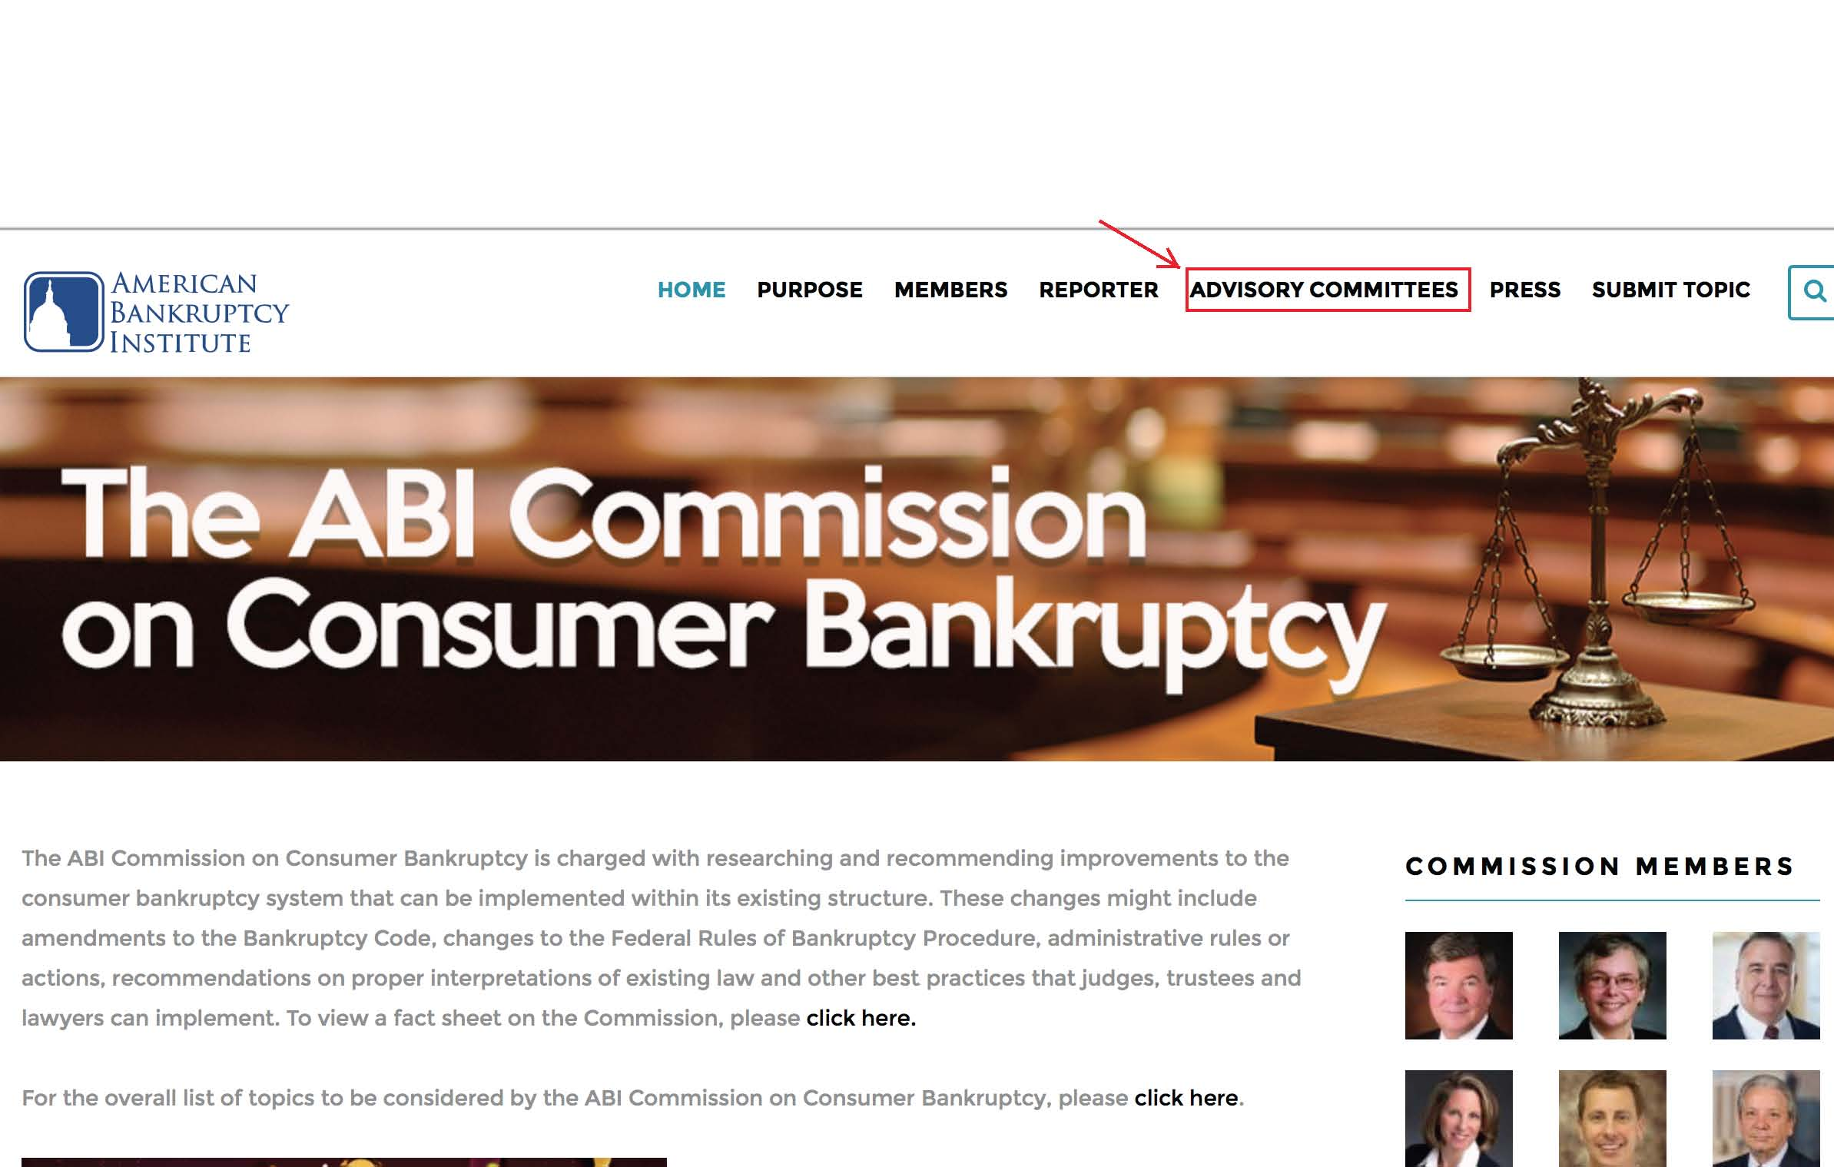

Slide 10
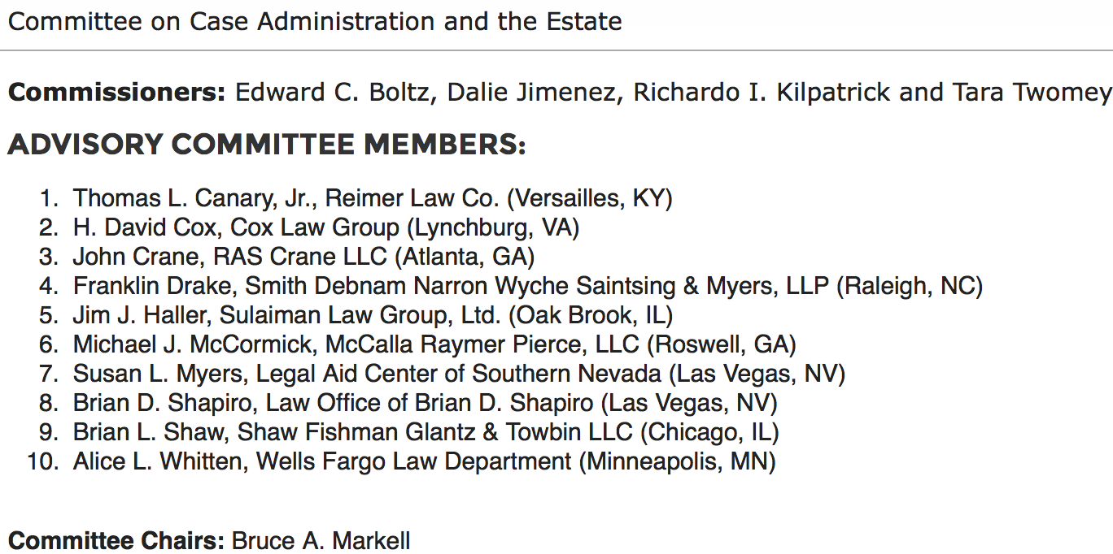

Slide 11
LIST OF TOPICS FOR ABI’S COMMISSION ON CONSUMER BANKRUPTCY
Committee on Case Administration & the Estate
Student loans
Roles and responsibilities of attorneys
Roles and responsibilities of U.S. Trustee/Bankruptcy Administrator
Systems issues
New bankruptcy forms
Notice and service issues
Prepetition repossession
Exemptions

Slide 12
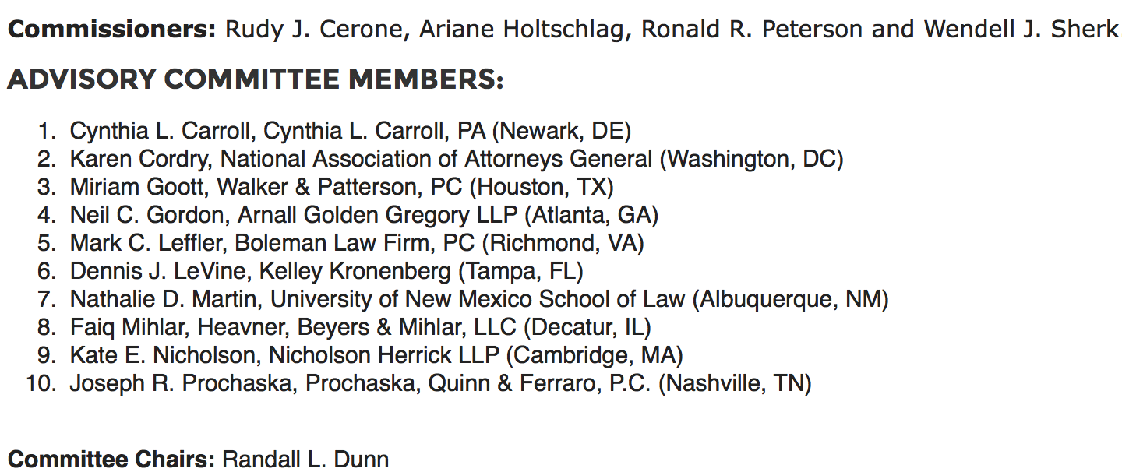

Slide 13
LIST OF TOPICS FOR ABI’S COMMISSION ON CONSUMER BANKRUPTCY
Committee on Chapter 7
Prepetition credit counseling and postpetition financial management course
Chapter 7 trustees [compensation; hiring counsel]
Dischargeability and discharge issues [523(a)(1)]
Means test
Property of the estate
Surrender
Redemption
Reaffirmation

Slide 14
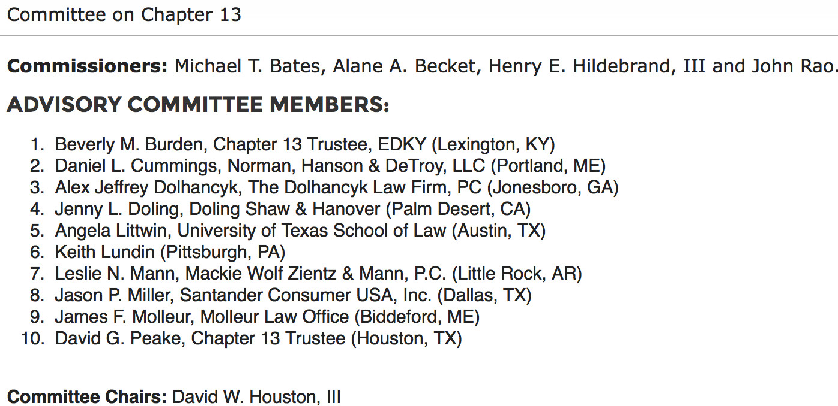

Slide 15
LIST OF TOPICS FOR ABI’S COMMISSION ON CONSUMER BANKRUPTCY
Committee on Chapter 13
Chapter 13 eligibility [debt limits]
FRBP 3002.1 issues
Homeowner issues [underwater mortgages]
Chapter 13 plans [conduit vs. direct pay]
Credit reporting and bankruptcy
Local legal culture and chapter 13 [chapter choice]
Section 1306, scope of estate property in unclosed cases

Slide 16
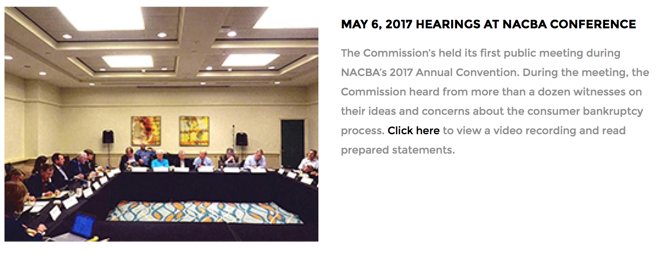

Slide 19
FUTURE COMMISSION EVENTS
Nov. 10, 2017 ABI Seventh Circuit Consumer Bankruptcy Conference (Chicago, IL) public meeting of the Commission
Dec. 1‐2, 2017 ABI Winter Leadership Conference (Palm Springs, CA) public meeting of the Commission
April 22‐24, 2018 ABI Annual Spring Meeting (Washington, DC) public meeting of the Commission
Dec. 6‐8, 2018 ABI publishes final report at 2018 Winter Leadership Conference

